Slide 1
Lasso model specifications

Slide 2
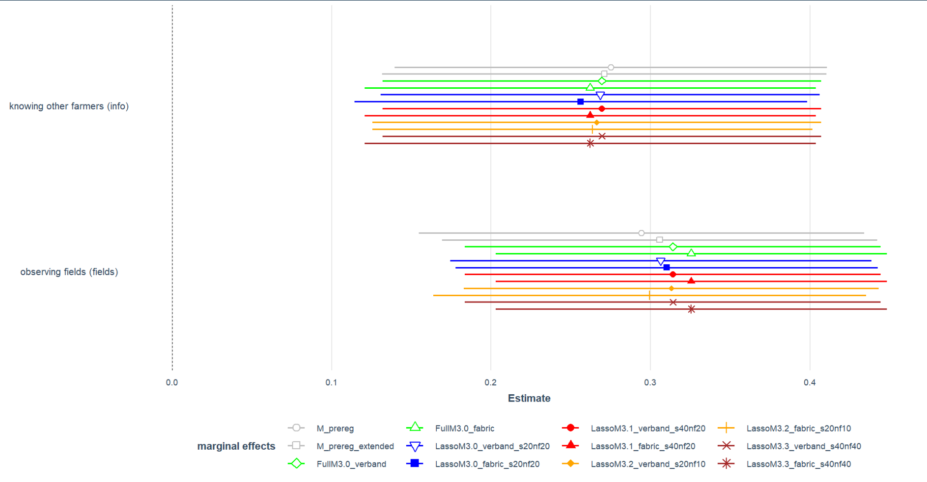
Different specifications – Fabrikstandort vs. Verband

Slide 3
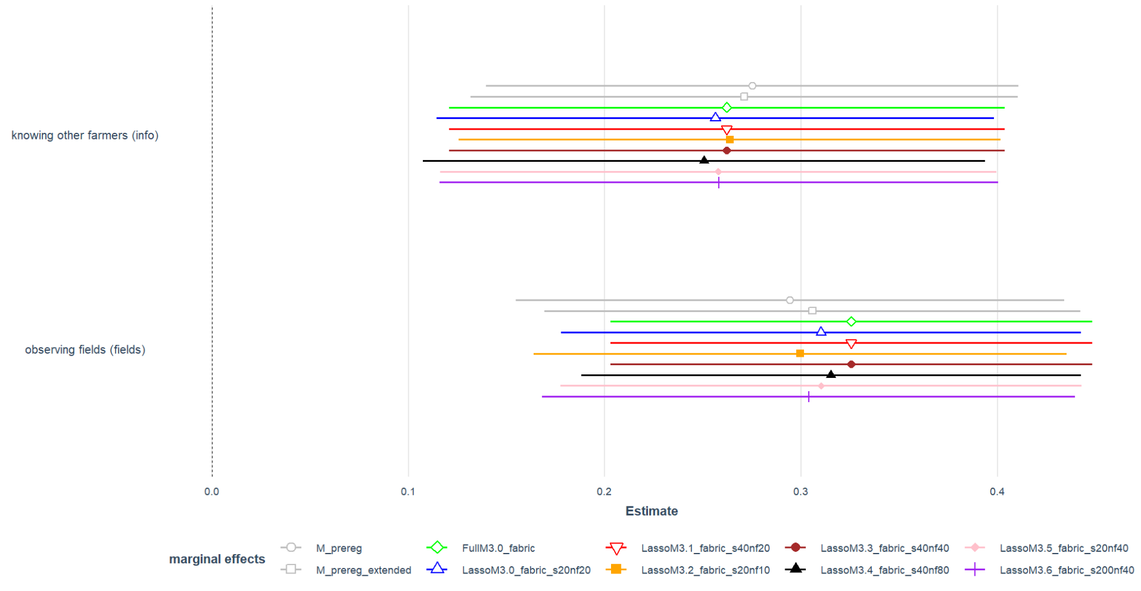
Fabrikstandort – diff. seeds and nfolds

Slide 4
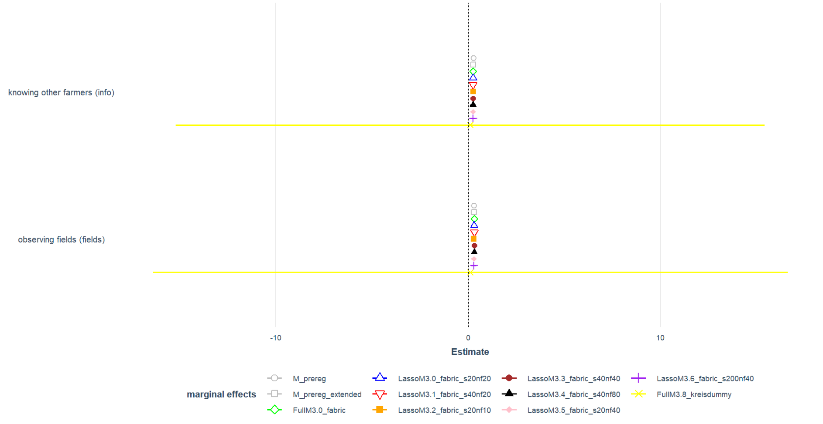
Fabrikstandort – compare to Kreisdummy

Slide 5
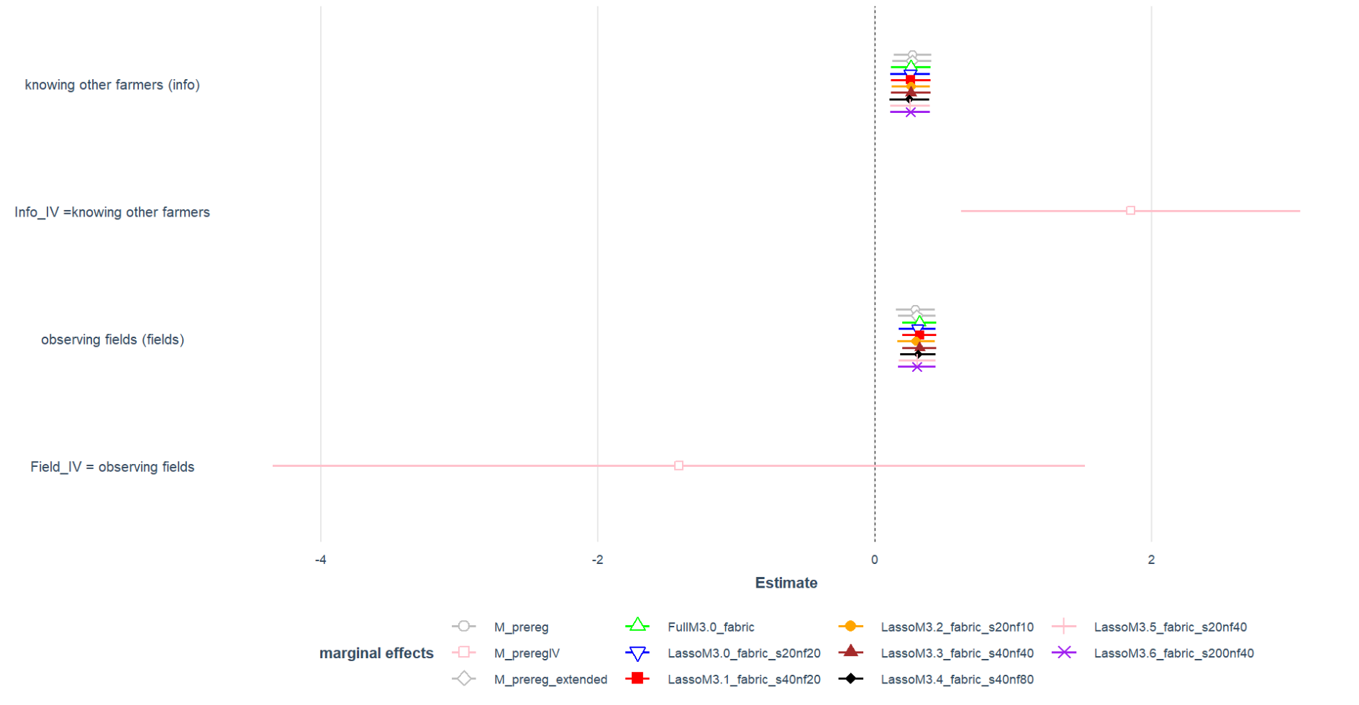
Fabrikstandort – compare to IV

Slide 6
List of vars Lasso can choose from
Variable Table, 25 vars, N = 289
Name | Label | Values | Missing
q1_adopt | Adoption mechanical weeding binary | '0' '1' | 0
fields_b | observing fields binary | '0' '1' | 0
info_b | knowing adopters binary | '0' '1' | 0
minDist_demo | minimal distance to demonstration farm | Num: 0.441 to 70.762 | 0
sq.demodist | squared minimal distance to demonstration farm | Num: 0.194 to 5007.198 | 0
farmsize_b | farm size in ha over 50 binary | '0' '1' | 0
AES_b | participation in AES binary | '0' '1' | 0
age_b | farmer age over 45 binary | '0' '1' | 0
farm_organic | production type binary | '0' '1' | 0
mainly_crop | farm specialized in crops/ arable farming binary | Num: 0 to 1 | 0
meanFarmSize2 | mean farm size at county level | Num: 18.204 to 336.495 | 0
ShareOrgFarms | Share of organic farms in all farms at county level | Num: 0 to 0.17 | 0
ShareOrgArea | Share of organic area in UAA at county level | Num: 0 to 0.209 | 0
populationdensity | habitants per sq.km | Num: 36 to 3077 | 0
farmDens | farms per sq.km | Num: 0.199 to 1.985 | 0
areaDens | UAA per total county area | Num: 0.139 to 0.705 | 0
ShareSmallFarms | Share of small farms (< 10ha in all farms at county level | Num: 0.062 to 0.532 | 0
elevation_in_m_mean | mean elevation at county or field level | Num: 12 to 533.4 | 0
sand_content_percent_mean | mean sand content in soil at county or field level | Num: 0.542 to 82.055 | 0
clay_content_percent_mean | mean clay content in soil at county or field level | Num: 5.442 to 35.609 | 0
sq.elevation_in_m_mean | sq.mean elevation at county or field level | Num: 144 to 284515.56 | 0
sq.sand_content_percent_mean | sq.mean sand content in soil at county or field level | Num: 0.294 to 6733.018 | 0
sq.clay_content_percent_mean | sq.mean clay content in soil at county or field level | Num: 29.613 to 1268.01 | 0
ShareArableUAA | share of arable area in total UAA | Num: 31.755 to 96.846 | 0
ShareArableInTotalArea | share of arable area in total county area | Num: 8.967 to 67.597 | 0
Fabrikstandort_agg | sugar factory location aggregated | 'Clauen' 'Elsdorf' 'LageNordst' 'Ochsenfurt' 'Offenau' and more | 0

Slide 7
Vars selected in different specifications
 |  | variable | n
1 | q_adopt | q_adopt | 11
2 | minDist_demo | minDist_demo | 11
3 | AES_b | AES_b | 11
4 | age_b | age_b | 11
5 | farm_organic | farm_organic | 11
6 | clay_content_percent_mean | clay_content_percent_mean | 11
7 | ShareArableUAA | ShareArableUAA | 11
8 | fields_b | fields_b | 11
9 | info_b | info_b | 11
10 | ShareArableInTotalArea | ShareArableInTotalArea | 10
11 | farmDens | farmDens | 10
12 | ShareSmallFarms | ShareSmallFarms | 10
13 | sq.clay_content_percent_mean | sq.clay_content_percent_mean | 10
14 | sand_content_percent_mean | sand_content_percent_mean | 9
15 | mainly_crop | mainly_crop | 8
16 | meanFarmSize2 | meanFarmSize2 | 7
17 | ShareOrgFarms | ShareOrgFarms | 7
18 | areaDens | areaDens | 7
19 | Fabrikstandort_agg | Fabrikstandort_agg | 6
20 | sq.demodist | sq.demodist | 6
21 | populationdensity | populationdensity | 6
22 | elevation_in_m_mean | elevation_in_m_mean | 6
23 | sq.elevation_in_m_mean | sq.elevation_in_m_mean | 6
24 | sq.sand_content_percent_mean | sq.sand_content_percent_mean | 6
25 | farmsize_b | farmsize_b | 5
26 | ShareOrgArea | ShareOrgArea | 4
27 | Verband_agg | Verband_agg | 4

Slide 8
Vars selected in step 1 (adoption)
 | lstvarsselected3.0_fabric[["lstCoefAdoptmin"]] | lstvarsselected3.0_verband[["lstCoefAdoptmin"]] | lstvarsselected3.1_fabric[["lstCoefAdoptmin"]] | lstvarsselected3.1_verband[["lstCoefAdoptmin"]] | lstvarsselected3.2_fabric[["lstCoefAdoptmin"]] | lstvarsselected3.2_verband[["lstCoefAdoptmin"]] | lstvarsselected3.3_fabric[["lstCoefAdoptmin"]] | lstvarsselected3.3_verband[["lstCoefAdoptmin"]] | lstvarsselected3.4_fabric[["lstCoefAdoptmin"]] | lstvarsselected3.5_fabric[["lstCoefAdoptmin"]] | lstvarsselected3.6_fabric[["lstCoefAdoptmin"]] | lstvarsselected3.7_fabric[["lstCoefAdoptmin"]]
1 | minDist_demo | minDist_demo | minDist_demo | minDist_demo | minDist_demo | minDist_demo | minDist_demo | minDist_demo | minDist_demo | minDist_demo | minDist_demo | minDist_demo
2 | AES_b | sq.demodist | sq.demodist | sq.demodist | AES_b | sq.demodist | sq.demodist | sq.demodist | age_b | age_b | farm_organic | age_b
3 | age_b | farmsize_b | farmsize_b | farmsize_b | age_b | AES_b | farmsize_b | farmsize_b | farm_organic | farm_organic | clay_content_percent_mean | farm_organic
4 | farm_organic | age_b | AES_b | age_b | farm_organic | age_b | AES_b | age_b | clay_content_percent_mean | clay_content_percent_mean | ShareArableUAA | clay_content_percent_mean
5 | clay_content_percent_mean | farm_organic | age_b | farm_organic | areaDens | farm_organic | age_b | farm_organic | ShareArableUAA | ShareArableUAA | ShareArableInTotalArea | ShareArableUAA
6 | ShareArableUAA | mainly_crop | farm_organic | mainly_crop | clay_content_percent_mean | mainly_crop | farm_organic | mainly_crop | ShareArableInTotalArea | ShareArableInTotalArea |  | ShareArableInTotalArea
7 | ShareArableInTotalArea | ShareOrgFarms | mainly_crop | meanFarmSize2 | ShareArableUAA | meanFarmSize2 | mainly_crop | meanFarmSize2 | Fabrikstandort_agg | Fabrikstandort_agg
8 | Fabrikstandort_agg | populationdensity | meanFarmSize2 | ShareOrgFarms | ShareArableInTotalArea | ShareOrgFarms | meanFarmSize2 | ShareOrgFarms
9 |  | farmDens | ShareOrgFarms | ShareOrgArea | Fabrikstandort_agg | populationdensity | ShareOrgFarms | ShareOrgArea
10 |  | areaDens | ShareOrgArea | populationdensity |  | farmDens | ShareOrgArea | populationdensity
11 |  | ShareSmallFarms | populationdensity | farmDens |  | areaDens | populationdensity | farmDens
12 |  | elevation_in_m_mean | farmDens | areaDens |  | ShareSmallFarms | farmDens | areaDens
13 |  | sand_content_percent_mean | areaDens | ShareSmallFarms |  | elevation_in_m_mean | areaDens | ShareSmallFarms
14 |  | clay_content_percent_mean | ShareSmallFarms | elevation_in_m_mean |  | clay_content_percent_mean | ShareSmallFarms | elevation_in_m_mean
15 |  | sq.elevation_in_m_mean | elevation_in_m_mean | sand_content_percent_mean |  | sq.elevation_in_m_mean | elevation_in_m_mean | sand_content_percent_mean
16 |  | sq.sand_content_percent_mean | sand_content_percent_mean | clay_content_percent_mean |  | sq.sand_content_percent_mean | sand_content_percent_mean | clay_content_percent_mean
17 |  | sq.clay_content_percent_mean | clay_content_percent_mean | sq.elevation_in_m_mean |  | sq.clay_content_percent_mean | clay_content_percent_mean | sq.elevation_in_m_mean
18 |  | ShareArableUAA | sq.elevation_in_m_mean | sq.sand_content_percent_mean |  | ShareArableUAA | sq.elevation_in_m_mean | sq.sand_content_percent_mean
19 |  | ShareArableInTotalArea | sq.sand_content_percent_mean | sq.clay_content_percent_mean |  | Verband_agg | sq.sand_content_percent_mean | sq.clay_content_percent_mean
20 |  | Verband_agg | sq.clay_content_percent_mean | ShareArableUAA |  |  | sq.clay_content_percent_mean | ShareArableUAA
21 |  |  | ShareArableUAA | ShareArableInTotalArea |  |  | ShareArableUAA | ShareArableInTotalArea
22 |  |  | ShareArableInTotalArea | Verband_agg |  |  | ShareArableInTotalArea | Verband_agg
23 |  |  | Fabrikstandort_agg |  |  |  | Fabrikstandort_agg

Slide 9
Vars selected in step 2 (info)
 | lstvarsselected3.0_fabric[["lstCoefinfomin"]] | lstvarsselected3.0_verband[["lstCoefAdoptmin"]] | lstvarsselected3.1_fabric[["lstCoefAdoptmin"]] | lstvarsselected3.1_verband[["lstCoefinfomin"]] | lstvarsselected3.2_fabric[["lstCoefinfomin"]] | lstvarsselected3.2_verband[["lstCoefinfomin"]] | lstvarsselected3.3_fabric[["lstCoefAdoptmin"]] | lstvarsselected3.3_verband[["lstCoefinfomin"]] | lstvarsselected3.4_fabric[["lstCoefinfomin"]] | lstvarsselected3.5_fabric[["lstCoefinfomin"]] | lstvarsselected3.6_fabric[["lstCoefinfomin"]] | lstvarsselected3.7_fabric[["lstCoefinfomin"]]
1 | AES_b | minDist_demo | minDist_demo | minDist_demo |  |  | minDist_demo | AES_b | AES_b | AES_b | AES_b | AES_b
2 | age_b | sq.demodist | sq.demodist | AES_b |  |  | sq.demodist | age_b | age_b | age_b | age_b | age_b
3 | farmDens | farmsize_b | farmsize_b | age_b |  |  | farmsize_b | mainly_crop | mainly_crop | mainly_crop | farmDens | mainly_crop
4 | ShareSmallFarms | age_b | AES_b | mainly_crop |  |  | AES_b | meanFarmSize2 | meanFarmSize2 | meanFarmSize2 | ShareSmallFarms | meanFarmSize2
5 | sand_content_percent_mean | farm_organic | age_b | ShareOrgFarms |  |  | age_b | ShareOrgFarms | ShareOrgFarms | farmDens | sand_content_percent_mean | farmDens
6 | sq.clay_content_percent_mean | mainly_crop | farm_organic | farmDens |  |  | farm_organic | farmDens | farmDens | ShareSmallFarms | sq.clay_content_percent_mean | ShareSmallFarms
7 |  | ShareOrgFarms | mainly_crop | ShareSmallFarms |  |  | mainly_crop | ShareSmallFarms | ShareSmallFarms | sand_content_percent_mean |  | sand_content_percent_mean
8 |  | populationdensity | meanFarmSize2 | sand_content_percent_mean |  |  | meanFarmSize2 | sand_content_percent_mean | sand_content_percent_mean | sq.clay_content_percent_mean |  | sq.clay_content_percent_mean
9 |  | farmDens | ShareOrgFarms | sq.clay_content_percent_mean |  |  | ShareOrgFarms | sq.clay_content_percent_mean | sq.clay_content_percent_mean
10 |  | areaDens | ShareOrgArea |  |  |  | ShareOrgArea
11 |  | ShareSmallFarms | populationdensity |  |  |  | populationdensity
12 |  | elevation_in_m_mean | farmDens |  |  |  | farmDens
13 |  | sand_content_percent_mean | areaDens |  |  |  | areaDens
14 |  | clay_content_percent_mean | ShareSmallFarms |  |  |  | ShareSmallFarms
15 |  | sq.elevation_in_m_mean | elevation_in_m_mean |  |  |  | elevation_in_m_mean
16 |  | sq.sand_content_percent_mean | sand_content_percent_mean |  |  |  | sand_content_percent_mean
17 |  | sq.clay_content_percent_mean | clay_content_percent_mean |  |  |  | clay_content_percent_mean
18 |  | ShareArableUAA | sq.elevation_in_m_mean |  |  |  | sq.elevation_in_m_mean
19 |  | ShareArableInTotalArea | sq.sand_content_percent_mean |  |  |  | sq.sand_content_percent_mean
20 |  | Verband_agg | sq.clay_content_percent_mean |  |  |  | sq.clay_content_percent_mean
21 |  |  | ShareArableUAA |  |  |  | ShareArableUAA
22 |  |  | ShareArableInTotalArea |  |  |  | ShareArableInTotalArea
23 |  |  | Fabrikstandort_agg |  |  |  | Fabrikstandort_agg

Slide 10
 | Pre-reg | Pre-reg IV | Pre-reg extended with regional vars based on economic intuition | Lasso selected vars (out of 35 | # of selection
1 | Info_b | Info_b | Info_b | info_b | 7
2 | fields_b | fields_b | fields_b | fields_b | 7
5 | minDist_demo | minDist_demo | minDist_demo | minDist_demo | 7
6 | sq.demodist | sq.demodist | sq.demodist | farm_organic | 7
7 | age_b | age_b | age_b | age_b | 6
8 | farmsize_b | farmsize_b | farmsize_b | farmsize_b | 1
9 | AES_b | AES_b | AES_b | AES_b | 4
10 | Fabrikstandort_agg | Fabrikstandort_agg | Fabrikstandort_agg | Fabrikstandort_agg | 3
11 | FieldDist | ShareOrgFarms (IV1 |  | ShareOrgFarms | 3
12 | FieldDist^2 | ShareOrgArea (IV2 |  | ShareOrgArea | 1
13 |  |  | SB_region
14 |  |  | meanFarmSize2 | meanFarmSize2 | 4
15 |  |  | sand_content_percent_mean | sand_content_percent_mean | 4
16 |  |  | elevation_in_m_mean | elevation_in_m_mean | 2
17 |  |  |  | populationdensity | 3
18 |  |  |  | ShareSmallFarms | 3
19 |  |  |  | population | 7
20 |  |  |  | farmDens | 3
21 |  |  |  | sq.elevation_in_m_mean | 3
22 |  |  |  | sq.clay_content_percent_mean | 3
23 |  |  |  | mainly_crop | 3
24 |  |  |  | lwBetr5b_Anzahl | 2
25 |  |  |  | UAA_Organic | 2
26 |  |  |  | sq.sand_content_percent_mean | 2
27 |  |  |  | sq.demodist | 2
28 |  |  |  | UAA_Sugarbeet | 2
29 |  |  |  | UAA | 2
30 |  |  |  | areaDens | 7
31 |  |  |  | clay_content_percent_mean | 7
32 |  |  |  | ShareSB | 1
33 |  |  |  | lwBetr_Anzahl | 1
34 |  |  |  | lwBetrOrganic_Anzahl | 1
35 |  |  |  | UAA_arable | 1
36 |  |  |  | lwBetrUnter5_Anzahl | 4
37 |  |  |  | Area | 7
Distance var. looked at separately + in subsample of observers

Slide 11
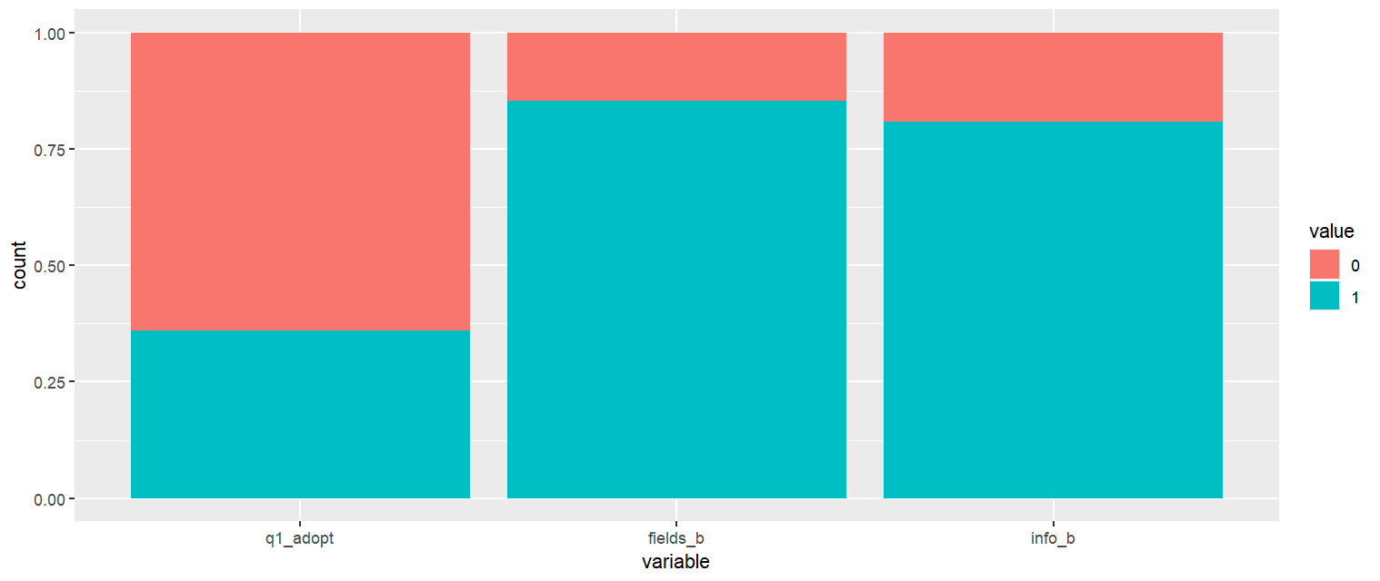
Vars of interest

Slide 12
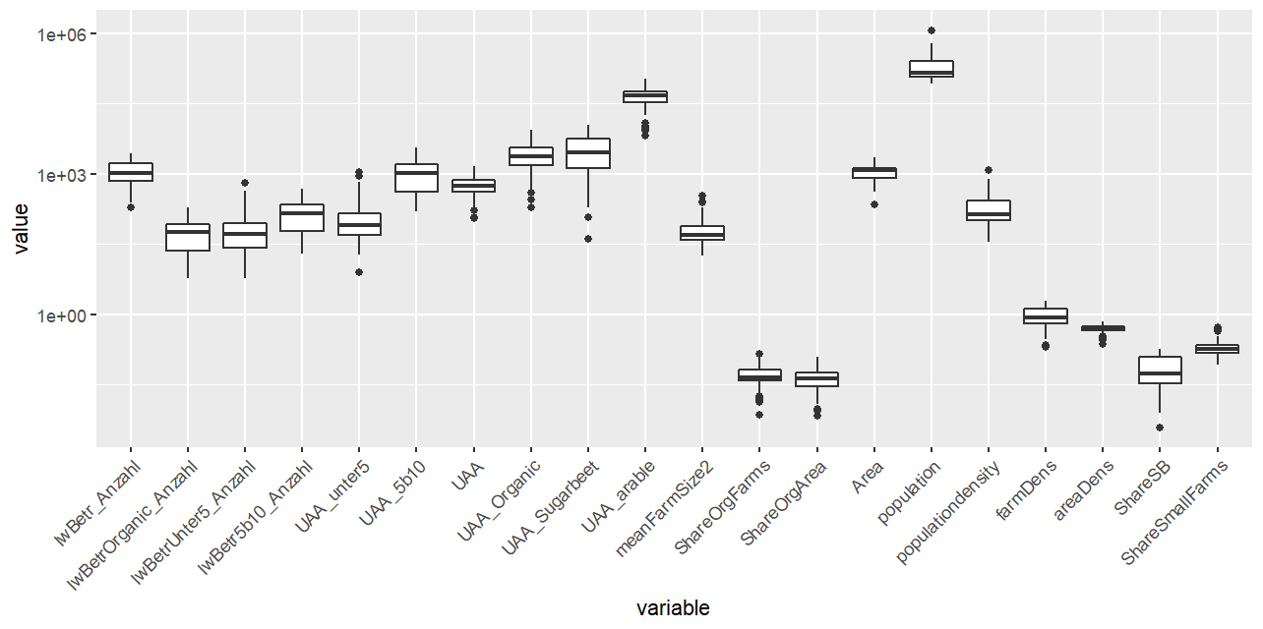
Farm structural vars
Exclude due to many missing values → als share

Slide 13
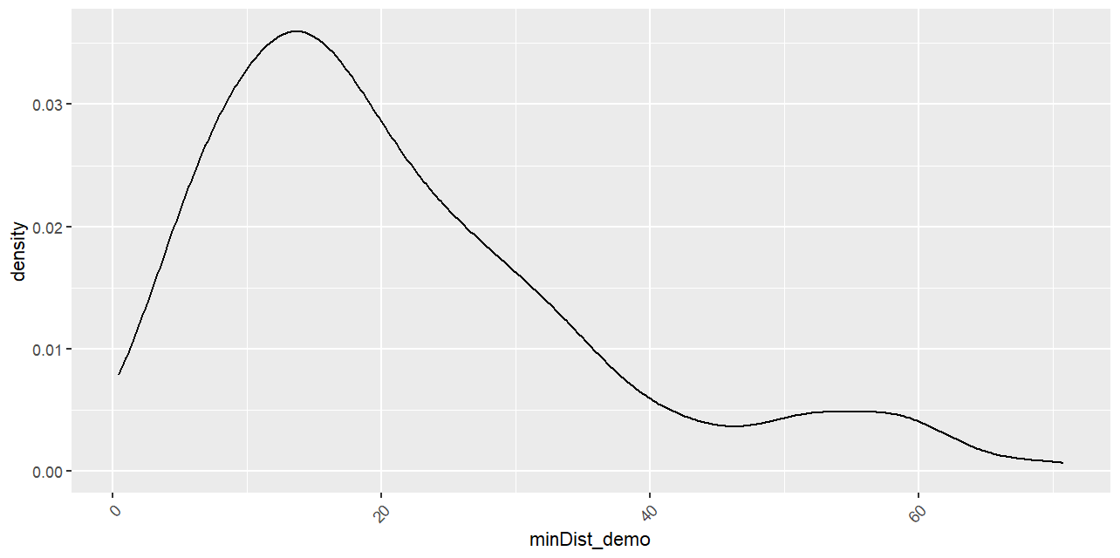
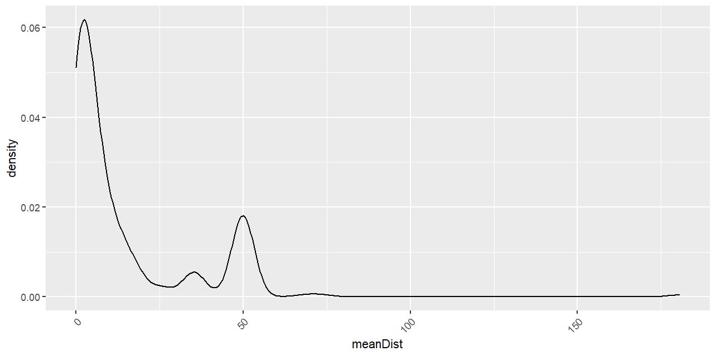
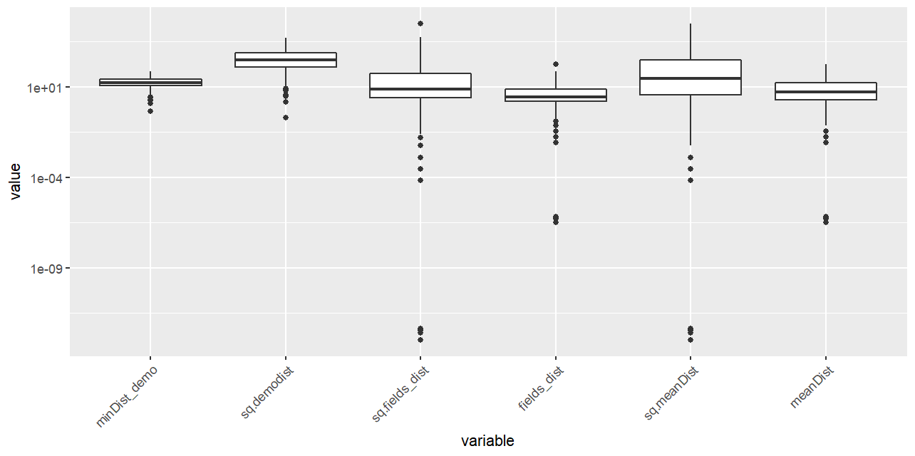
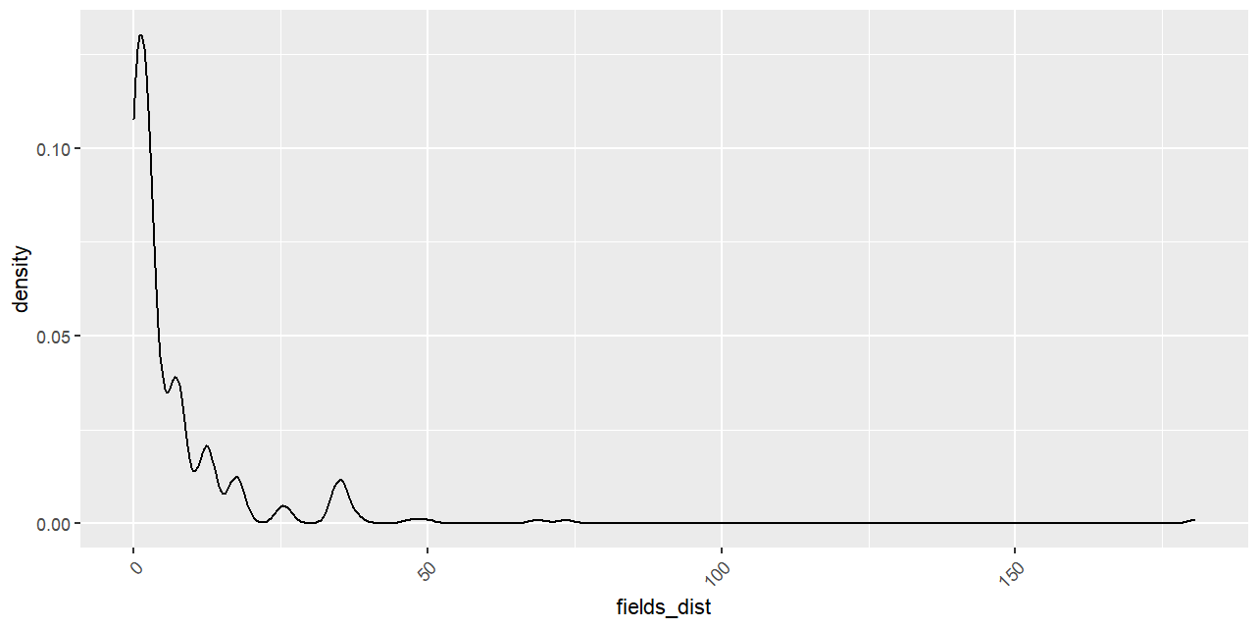
Distance vars
Those who don’t observe set to 50, @AM:need to cut others

Slide 14
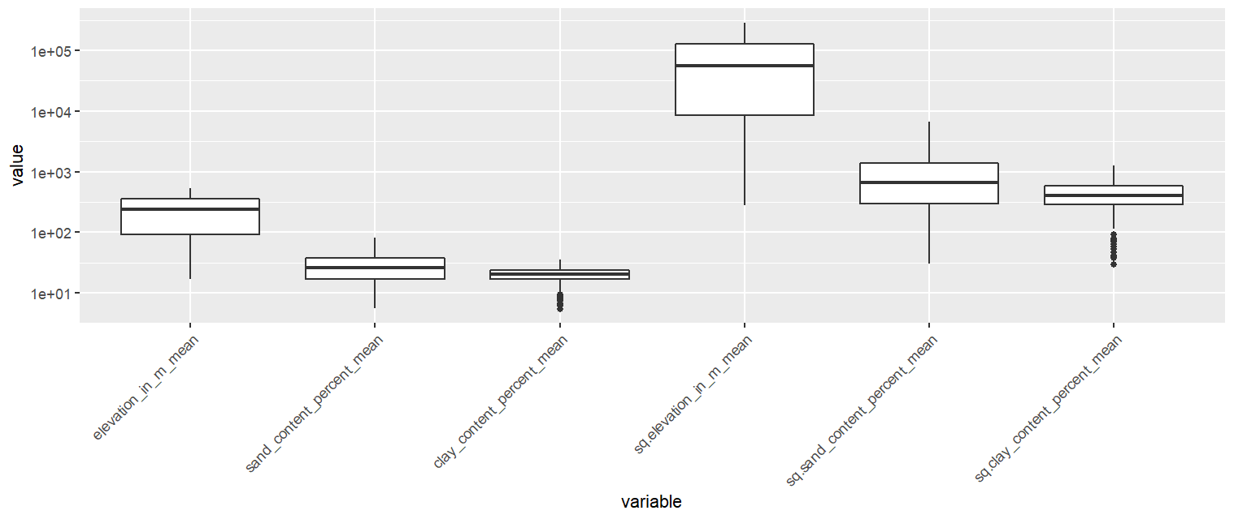
Soil vars

Slide 15
Sugarbeet vars

Slide 16
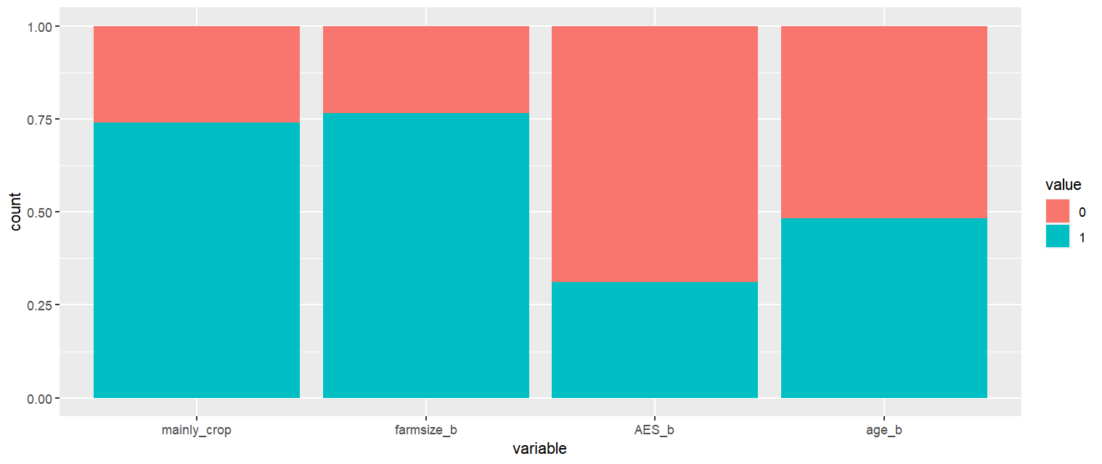
Demographics from survey

Slide 17
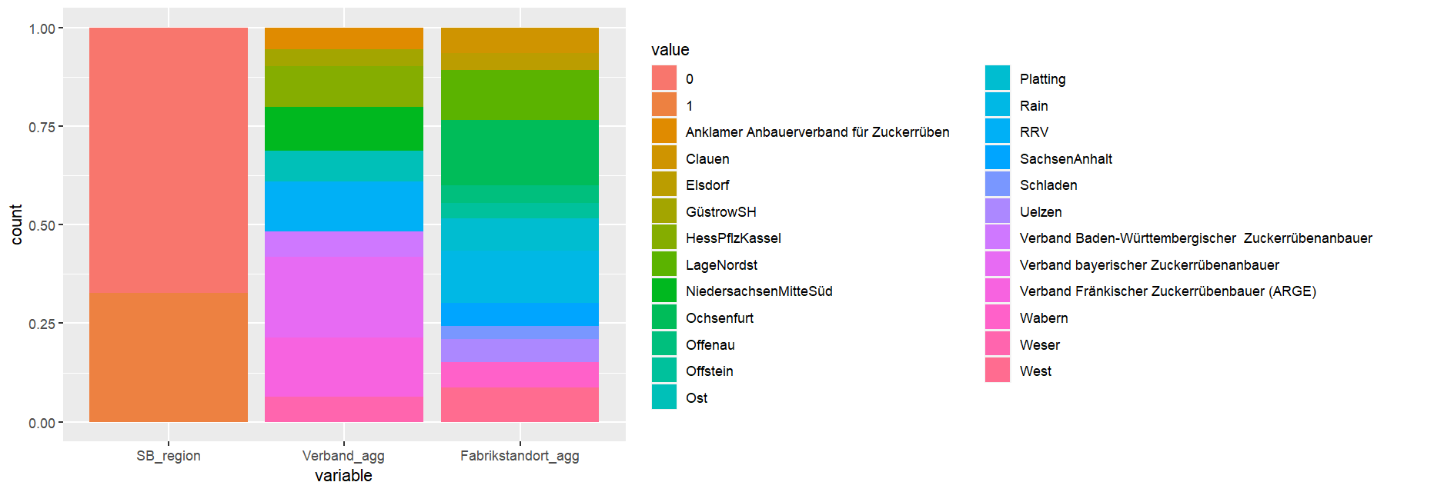
SB production structures
Take only one of those, currently (Fabrikstandort_agg otherwise partial overlap → @AM: check if results differ if Verband_agg taken
Binary version of Share_SB (takes 11 if > 10%

Slide 18
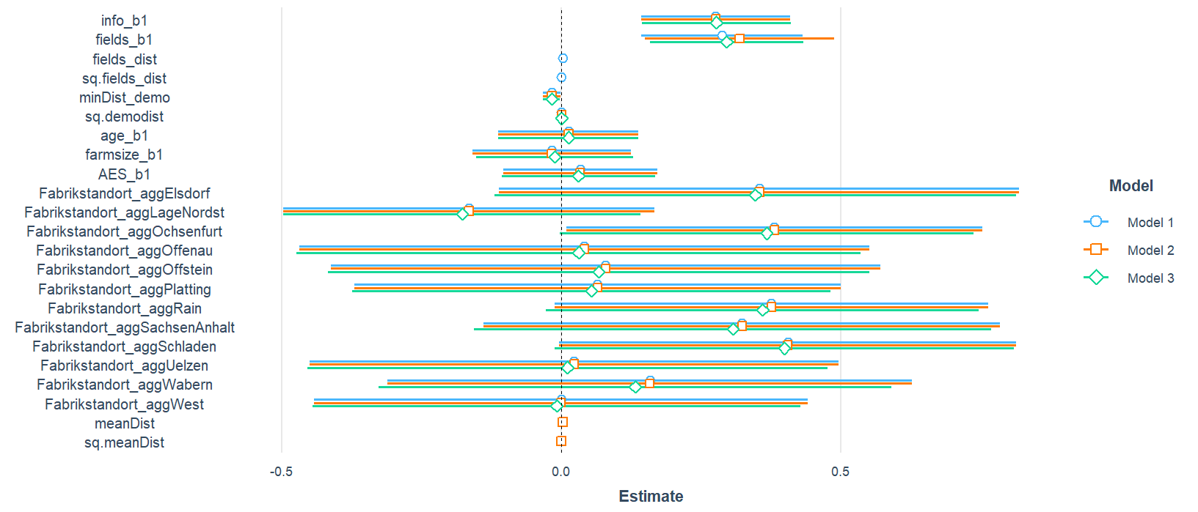
How should distance to fields observed enter? → not all!

Slide 19
Compare observers and non-observers
Name | Label | Observers | Non-Observers
q1_adopt | Adoption mechanical weeding binary
fields_b | observing fields binary
info_b | knowing adopters binary
minDist_demo | minimal distance to demonstration farm | mean: 21.512 | mean: 18.894
sq.demodist | squared minimal distance to demonstration farm | mean: 674.549 | mean: 494.805
farmsize_b | farm size in ha over 50 binary
AES_b | participation in AES binary
age_b | farmer age over 45 binary
farm_organic | production type binary
mainly_crop | farm specialized in crops/ arable farming binary | mean: 0.755 | mean: 0.714
meanFarmSize2 | mean farm size at county level | mean: 58.348 | mean: 64.616
ShareOrgFarms | Share of organic farms in all farms at county level | mean: 0.054 | mean: 0.048
ShareOrgArea | Share of organic area in UAA at county level | mean: 0.052 | mean: 0.046
populationdensity | habitants per sq.km | mean: 218.679 | mean: 361.405
farmDens | farms per sq.km | mean: 1.097 | mean: 0.934
areaDens | UAA per total county area | mean: 0.516 | mean: 0.481
ShareSmallFarms | Share of small farms (< 10ha) in all farms at county level | mean: 0.213 | mean: 0.232
elevation_in_m_mean | mean elevation at county or field level | mean: 266.163 | mean: 181.524
sand_content_percent_mean | mean sand content in soil at county or field level | mean: 27.342 | mean: 34.616
clay_content_percent_mean | mean clay content in soil at county or field level | mean: 21.441 | mean: 18.494
sq.elevation_in_m_mean | sq.mean elevation at county or field level | mean: 88106.039 | mean: 46892.525
sq.sand_content_percent_mean | sq.mean sand content in soil at county or field level | mean: 1005.399 | mean: 1620.596
sq.clay_content_percent_mean | sq.mean clay content in soil at county or field level | mean: 491.35 | mean: 382.509
ShareArableUAA | share of arable area in total UAA | mean: 80.651 | mean: 80.603
ShareArableInTotalArea | share of arable area in total county area | mean: 42.162 | mean: 39.706
Fabrikstandort_agg | sugar factory location aggregated

Slide 20
Name | Class | Label | Values | Summary
q1_adopt | labelled | Adoption mechanical weeding binary | '0' '1'
fields_b | labelled | observing fields binary | '0'
info_b | labelled | knowing adopters binary | '0' '1'
minDist_demo | labelled | minimal distance to demonstration farm | Num: 1.926 to 54.007 | mean: 18.894
sq.demodist | labelled | squared minimal distance to demonstration farm | Num: 3.711 to 2916.763 | mean: 494.805
farmsize_b | labelled | farm size in ha over 50 binary | '0' '1'
AES_b | labelled | participation in AES binary | '0' '1'
age_b | labelled | farmer age over 45 binary | '0' '1'
farm_organic | labelled | production type binary | '0' '1'
mainly_crop | labelled | farm specialized in crops/ arable farming binary | Num: 0 to 1 | mean: 0.714
meanFarmSize2 | labelled | mean farm size at county level | Num: 20.576 to 152.397 | mean: 64.616
ShareOrgFarms | labelled | Share of organic farms in all farms at county level | Num: 0 to 0.152 | mean: 0.048
ShareOrgArea | labelled | Share of organic area in UAA at county level | Num: 0 to 0.209 | mean: 0.046
populationdensity | labelled | habitants per sq.km | Num: 63 to 1304 | mean: 361.405
farmDens | labelled | farms per sq.km | Num: 0.27 to 1.985 | mean: 0.934
areaDens | labelled | UAA per total county area | Num: 0.139 to 0.703 | mean: 0.481
ShareSmallFarms | labelled | Share of small farms (< 10ha) in all farms at county level | Num: 0.062 to 0.458 | mean: 0.232
elevation_in_m_mean | labelled | mean elevation at county or field level | Num: 12 to 460.43 | mean: 181.524
sand_content_percent_mean | labelled | mean sand content in soil at county or field level | Num: 5.76 to 82.055 | mean: 34.616
clay_content_percent_mean | labelled | mean clay content in soil at county or field level | Num: 5.442 to 29.055 | mean: 18.494
sq.elevation_in_m_mean | labelled | sq.mean elevation at county or field level | Num: 144 to 211996.17 | mean: 46892.525
sq.sand_content_percent_mean | labelled | sq.mean sand content in soil at county or field level | Num: 33.174 to 6733.018 | mean: 1620.596
sq.clay_content_percent_mean | labelled | sq.mean clay content in soil at county or field level | Num: 29.616 to 844.185 | mean: 382.509
ShareArableUAA | labelled | share of arable area in total UAA | Num: 39.256 to 96.846 | mean: 80.603
ShareArableInTotalArea | labelled | share of arable area in total county area | Num: 9.519 to 67.597 | mean: 39.706
Fabrikstandort_agg | labelled | sugar factory location aggregated | 'Clauen' 'Elsdorf' 'LageNordst' 'Ochsenfurt' 'Offenau' and more
NonFieldsIV_compare
This data contains 42 rows and 26 columns.
Variable Table
vtable {vtable} | Variable Documentation

